Slide 1
Going Live

Slide 2
Objectives
In todays class we will…
Recap the basic topics covered to date
Offer a conceptual introduction to CSS reset and downloadable style sheets
Work with Google Developer tools for site inspection
Utilize Github Pages for website deployment

Slide 3
Check-Up Session
How’s it going?
After 1 week of Bootcamp, how are you holding up?
What feedback do you have so far?

Slide 4
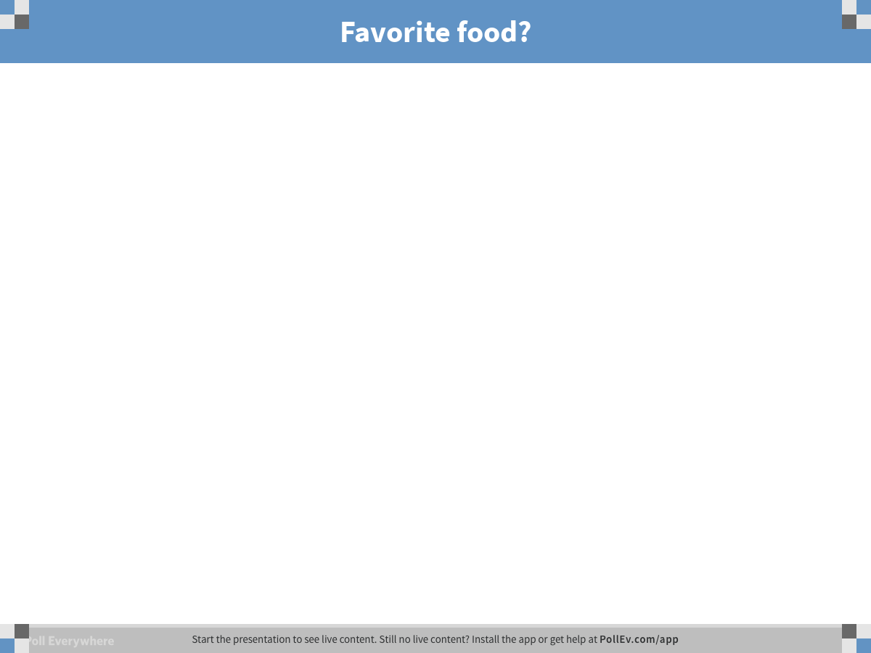
Notes:
Favorite food?
https://www.polleverywhere.com/free_text_polls/3ZX2MhcYNa1HxYz

Slide 5
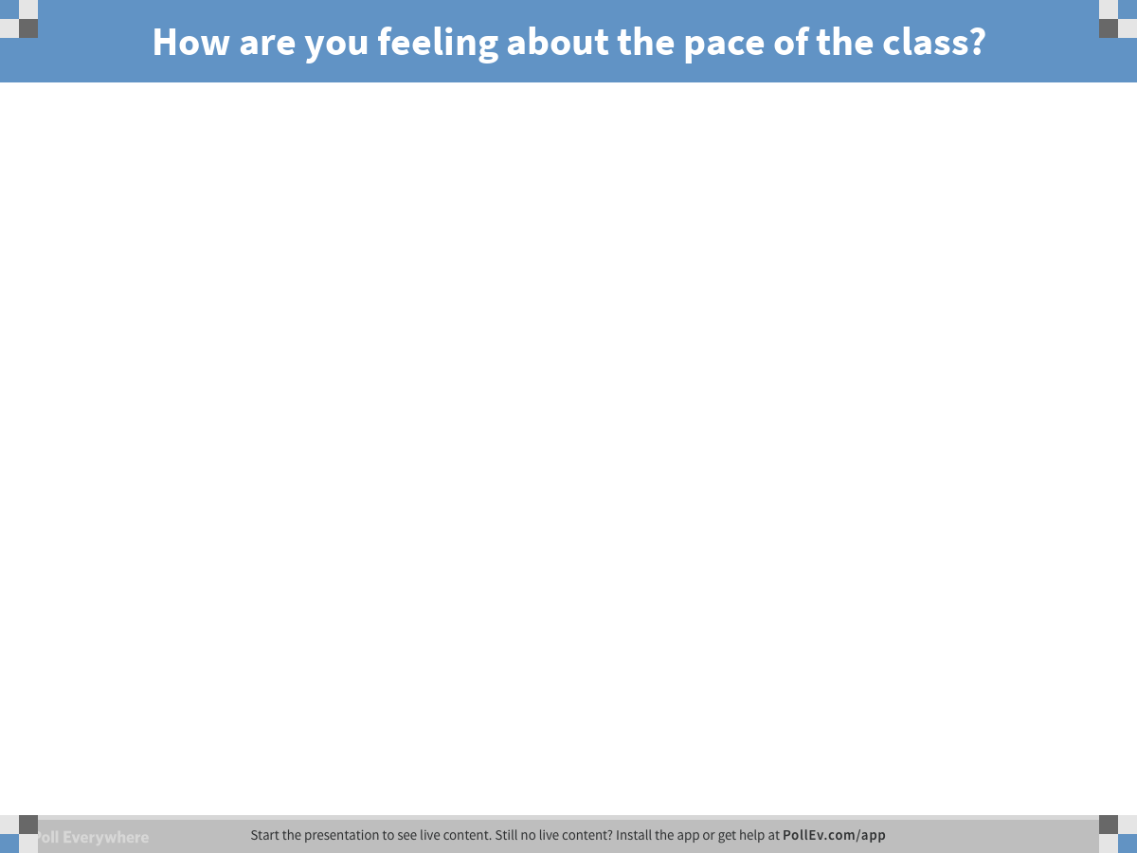
Notes:
How are you feeling about the pace of the class?
https://www.polleverywhere.com/free_text_polls/6f91lyAT2cWcONG

Slide 6
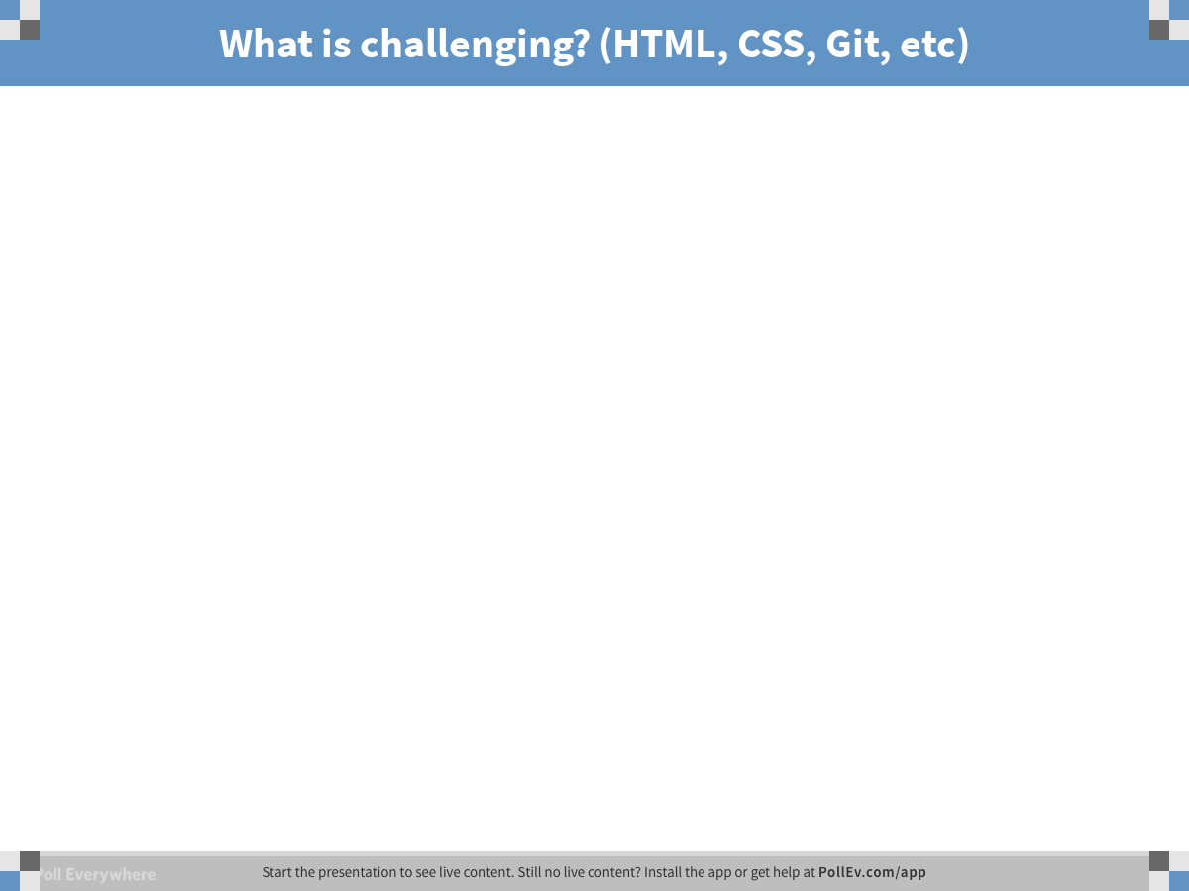
Notes:
What is challenging? (HTML, CSS, Git, etc)
https://www.polleverywhere.com/free_text_polls/xlG5XYz5kAhAF9N

Slide 7
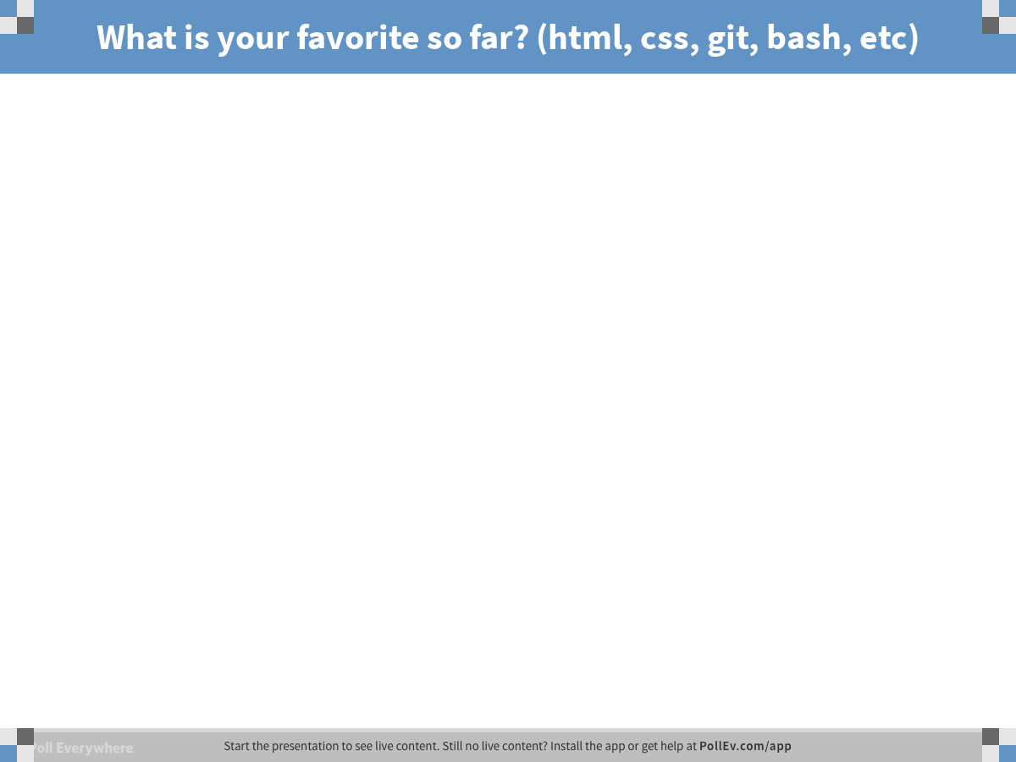
Notes:
What is your favorite so far? (html, css, git, bash, etc)
https://www.polleverywhere.com/free_text_polls/hFoyyTtNXW19v8y

Slide 8

Instructor Feedback
Seriously, mind-blown.

Slide 9
Instructor Feedback
Things I’ve noticed people doing incredibly well:
All of you are handling an enormous volume of information.
All of you are asking the right questions.
You notice the right details.
You all help each other out.
And, most importantly, you are figuring out things on your own.

Slide 10
A Few Admin Things…

Slide 11
Instructor Feedback
Remember, Homework #1 is due on Saturday.
Homework Link: https://nu.bootcampcontent.com/NU-Coding-Bootcamp/NUEVA201809FSF4/blob/master/homework%20assignments/01-week/recommended-homework-assignment.md
Remember to submit Homework via GitHub (& GitHub Pages): https://www.bootcampspot.com/coursework/26553/show
And seriously!
Submit whatever you have! Don’t get a 0.
(Even if you don’t like what you’ve made.)

Slide 12
Office Hours + Additional Help
Also, remember….
In Class Office Hours: 45 minutes before class, 30 minutes after.
Review In Class Material (Exercises and Slides): https://nu.bootcampcontent.com/NU-Coding-Bootcamp/NUEVA201809FSF4/tree/master
Re-Watch Class Videos:
Monday 9/24: https://www.bootcampspot.com/sessions/480686
Wednesday 9/26: https://www.bootcampspot.com/sessions/480687
Saturday 9/29: https://www.bootcampspot.com/sessions/480688

Slide 13
Recapping

Slide 14

Recap
In just one whirlwind week we’ve covered:
Full-Stack Development Conceptually
Terminal / Git Bash
HTML Syntax
Git Concepts and Commands
CSS Purpose, Syntax, and Styles
Floating
Positioning
Box Model
Chrome Dev Tools
How to Learn on Your Own!!

Slide 15

Full-Stack Development?

Slide 16

> Intro to Console

Slide 17


<title> Intro to HTML </title>
HTML is one of the three base languages behind every single website.
It defines all of the basic content and a bit of formatting.

Slide 18


Pushing and Pulling to GitHub
1
2
3
4
GitHub Branch
Pull Code
Push Code
Pull Code
Pull Code
Push Code
Pull Code
Push Code

Slide 19

CSS Syntax
CSS works by hooking onto selectors added into HTML using “classes and identifiers”.
Once hooked, we apply styles to those HTML elements using CSS.

Slide 20

The Concept of “Flow”
In HTML/CSS, (by default) every element displayed is governed by a concept called “flow.”
This means that HTML elements force their adjacent elements to flow around them.

Slide 21
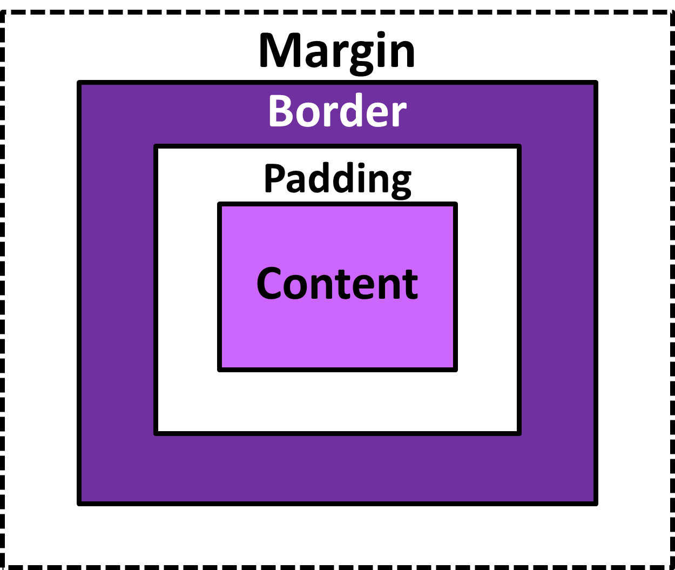
The Box Model
The Box Model wraps every CSS element in padding, border and margin – allowing developers to modify spacing styles.

Slide 22

CSS Positioning
We can orient our HTML elements in relation to space with CSS positioning (static, relative, fixed, absolute).

Slide 23









How to Learn…

Slide 24

General Questions / Issues?

Slide 25
Double Take

Slide 26
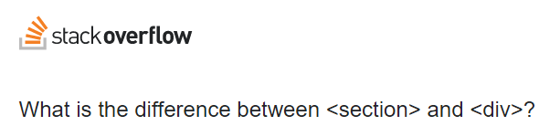
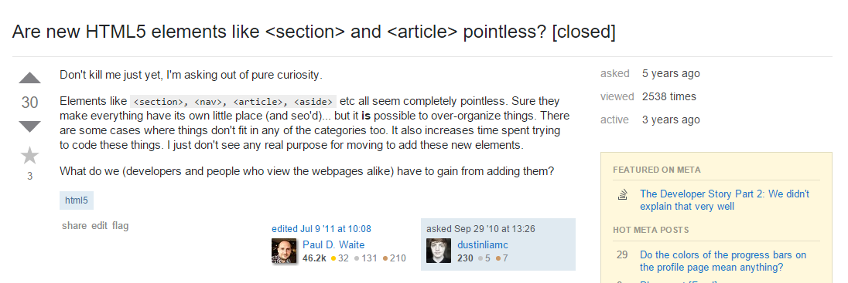
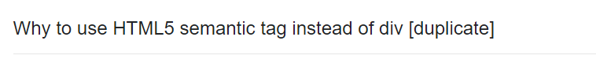
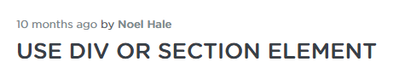
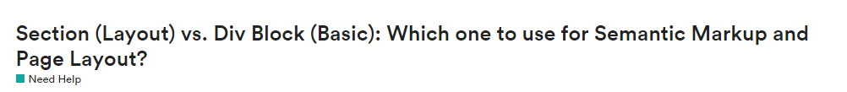
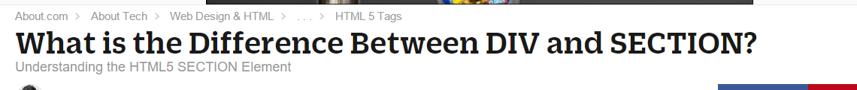
Divs, Sections, Navs, Etc….

Slide 27
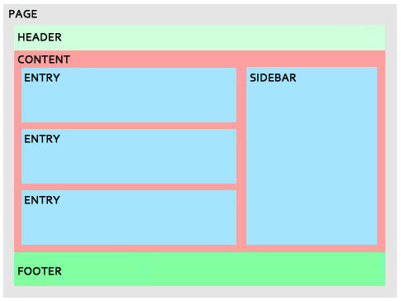
Divs, Sections, Navs, Etc….
All web layouts are inherently composed of containers, traditionally called “divs.”

Slide 28
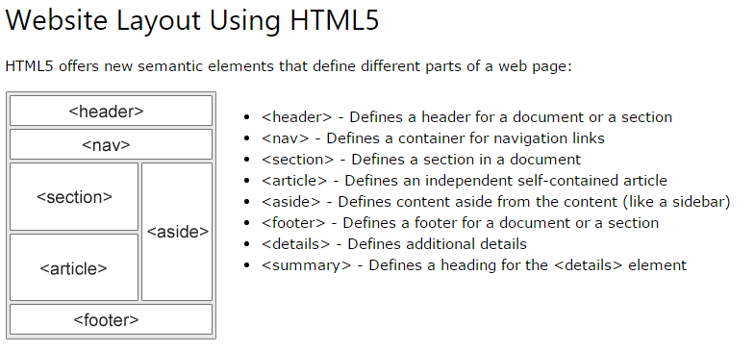
Divs, Sections, Navs, Etc….
HTML5 introduced the concept of “semantic layouts,” meaning “divs” could be given more meaningful names.
In theory, this helps with organization and search engine optimization.

Slide 29
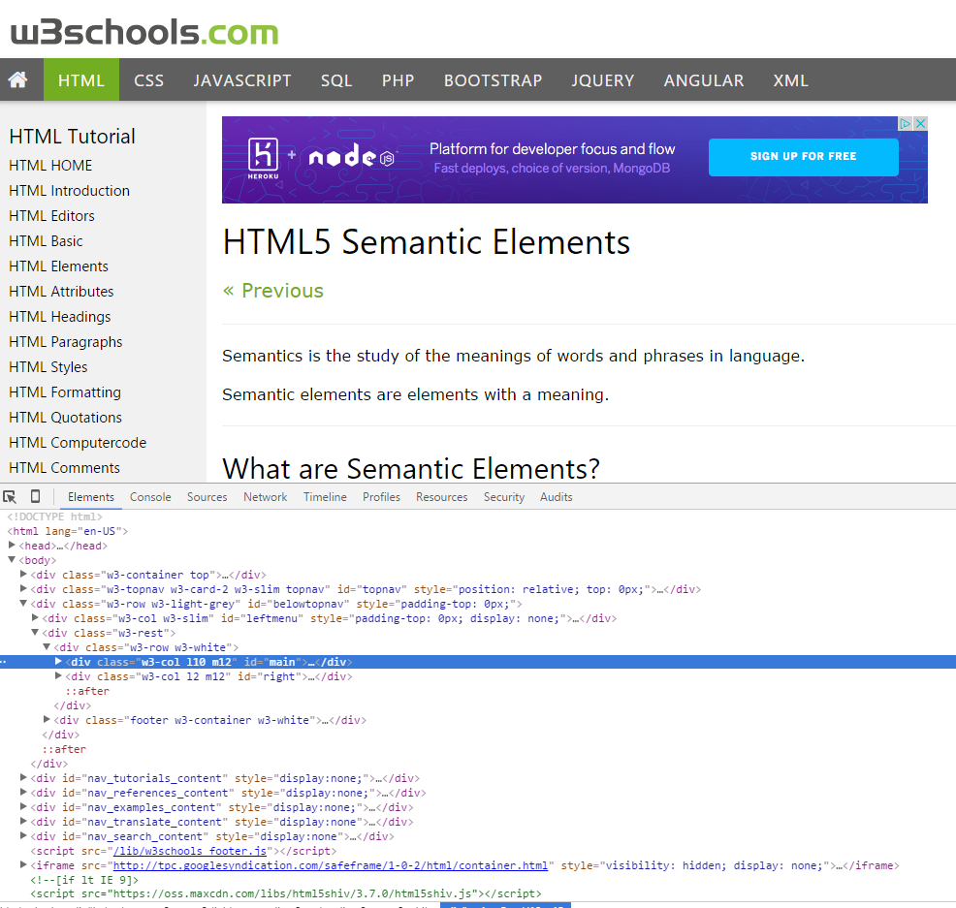
Divs, Sections, Navs, Etc….
That said… many (if not most) websites, seem to still be using basic divs.
There are reasons for this that we’ll showcase in later sections.
Additionally, it’s possible to include “semantics” by using id names and classes.

Slide 30
Divs, Sections, Navs, Etc….
div?
Section?
Bottom line: Follow your homework’s instructions. But when you get out in the “real world,” follow the convention of where you work!

Slide 31

Classes vs. IDs
Classes = Barcode (all iPod)
IDs = Serial Number (unique iPod)
When choosing between a CSS ID and a CSS Class follow the convention:
Classes (.classname) are to be used if the same style will be used on multiple HTML elements.
IDs (#idname) are to be used if a style is unique to that HTML element.

Slide 32
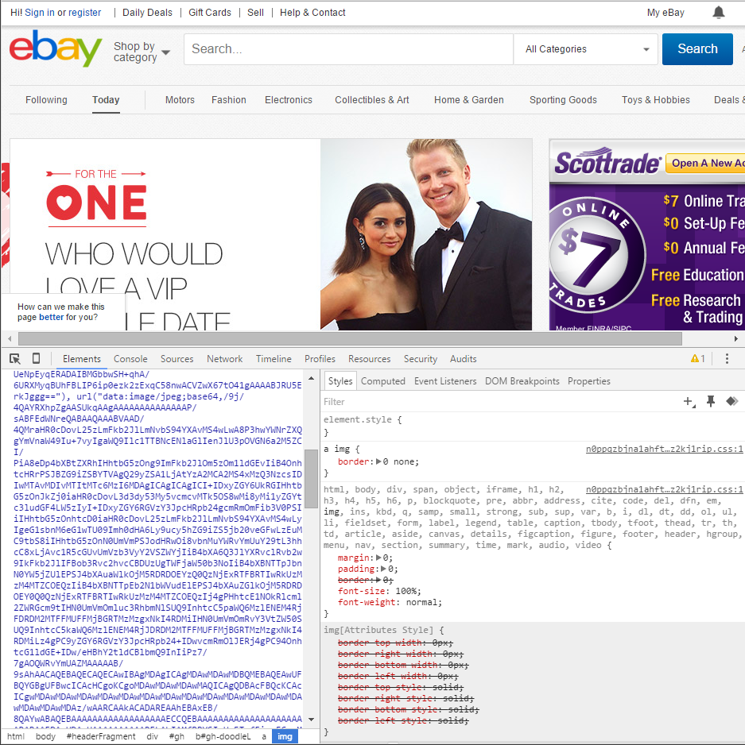
Chrome Developer Tools (Inspector)
This is one of the most frequent tools you will use in web development.
It allows you to truly debug your web designs.
Start using it!

Slide 33

Modifying Sites
You can edit any page’s HTML and CSS with Chrome Developer Tools.
Plus, you’ll see your results instantly.

Slide 34
INSTRUCTOR DEMO!
Instructor: Demo
(Chrome Developer Tools)
Notes:
34

Slide 35
> YOUR TURN!!
Suggested Time: 15 min
Assignment
For the next 15 minutes, take a website you commonly use (Amazon, Google, Huff Po, etc.) and heavily modify it using the Chrome Developer Tools.
Be sure to at least modify:
Content (Change words)
Colors
Spacing
Send a screenshot to the class’s slack channel when you’re done.

Slide 36
CSS Resets

Slide 37

Loading Multiple CSS Files ***(Very Important!!!)***
An incredibly powerful technique: deploying multiple CSS files simultaneously.
This lets developers to create complex designs made up of abounding design elements.
Just remember: the loading order matters!!!

Slide 38
INSTRUCTOR DEMO!
Instructor: Demo
(1-3_CSSFiles.html | 3-MultipleCSS)
Notes:
38

Slide 39
What Browser?
By a show of hands…
Which browser do you use?

Slide 40

Battle of the Browsers
Under the hood, web browsers often render web pages differently than their competition.
These disparities could mean HTML/CSS displaying differently in each web client.
Because of these potential divergences, web developers need to make their websites cross-browser compatible.

Slide 41

Reset.css (or Normalize.css)
Reset.css will “reset” all browser-specific CSS. This means your site will appear the same in all browsers.
However, you will have to re-style everything yourself.

Slide 42
INSTRUCTOR DEMO!
Instructor: Demo
(Example.html | 4-ResetCSS)
Notes:
42

Slide 43
Why CSS Resets Matter
It’s important for creating browser-compatible websites
It’s an example of using someone else’s CSS in your website!!!
It’s a common Front-End Developer Interview question.

Slide 44
> YOUR TURN!!
Suggested Time: 10 min
Assignment
Follow the instructions given via Slack to incorporate a reset.css file into a basic HTML file.
Note the impact the reset file makes after its inclusion.

Slide 45
To the Web with GitHub!

Slide 46
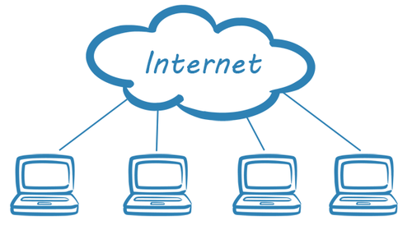
The Internet
A deep and complex diagram above on how the internet works.

Slide 47
The World Will See Our Greatness!
GitHub provides hosting for static websites – which means we can deploy our websites and applications onto their servers for the world to see.

Slide 48
Together Now…
Let’s all login to GitHub

Slide 49
INSTRUCTOR DEMO!
Instructor: Demo
(GitHub Pages Deployment - Personal)
Notes:
49

Slide 50
Deploying Static Personal Site – GitHub Pages
Basic Steps:
Create a new repo that is named `_username_.github.io`
Navigate into a folder and clone the repo into it
Build your files
Add, commit, and push your changes into the repository

Slide 51
> YOUR TURN!!
Suggested Time: 15 min
Assignment
Time to take your newfangled website and deploy it to the cloud (in this case, GitHub Pages).
Additional instructions to be sent via Slack.

Slide 52
INSTRUCTOR DEMO!
Instructor: Demo
(GitHub Pages Deployment - Project)
Notes:
52

Slide 53
Deploying a Static Project Site – GitHub Pages
Basic Steps:
1. Create a new repository on your GitHub account. You can name this repository whatever you would like.
2. Once inside of the repository, create a new file and name it `index.html`
3. Add some very basic HTML into this file, save it, and then navigate into your repository's Settings tab.
4. Scroll down to the GitHub Pages section and then, in the section labeled "Source", select that you would like to use the master branch as your source.
5. Navigate to `<username>.github.io/<repositoryname>` and you will find that your new web page has gone live!

Slide 54
> YOUR TURN!!
Suggested Time: 15 min
Assignment
Build a newfangled website, and deploy it to GitHub Pages as a project instead of a personal site.
Additional instructions to be sent via Slack.

Slide 55
Practice Through Frustration
Keep Practicing!
It gets better.

Slide 56
Questions?

Slide 57
Homework 1 - Help?

Slide 58
EXTRA MATERIAL

Slide 59
And Back to Git…

